Slide 1
Demo AWS Topology

Slide 2



Demo AWS Topology
A

Slide 3



Demo AWS Topology
A
Browser

Slide 4

Demo AWS Topology
AWS Cloud
A
Browser

Slide 5

Demo AWS Topology
AWS Cloud
Region us-east-1
A
Browser

Slide 6

Demo AWS Topology
AWS Cloud
Region us-east-1
A
Amazon Cognito
Browser

Slide 7
Demo AWS Topology
AWS Cloud
Region us-east-1
A
Amazon Cognito
Browser
Step 1: Authenticate to Cognito User Pool

Slide 8

Demo AWS Topology
AWS Cloud
Region us-east-1
A
Amazon Cognito
Browser
JWT
Step 2: If Successful Receive JWT Token

Slide 9
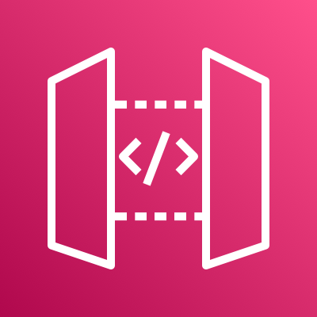
Demo AWS Topology
AWS Cloud
Region us-east-1
A
Amazon Cognito
Browser
JWT
AWS API Gateway

Slide 10
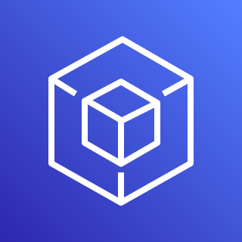
Demo AWS Topology
AWS Cloud
Region us-east-1
A
Amazon Cognito
Browser
JWT
AWS API Gateway
AWS SDK

Slide 11
Demo AWS Topology
AWS Cloud
Region us-east-1
A
Amazon Cognito
Browser
JWT
/demo/cup
AWS API Gateway
AWS SDK

Slide 12

Demo AWS Topology
AWS Cloud
Region us-east-1
A
Amazon Cognito
Browser
/cup
JWT
/demo/cup
/CUP
/CIP
AWS API Gateway
AWS SDK
/GOOGLE

Slide 13

Demo AWS Topology
AWS Cloud
Region us-east-1
A
Amazon Cognito
Browser
/cup
JWT
/demo/cup
/CUP
/CIP
AWS API Gateway
AWS Lambda
AWS SDK
/GOOGLE

Slide 14
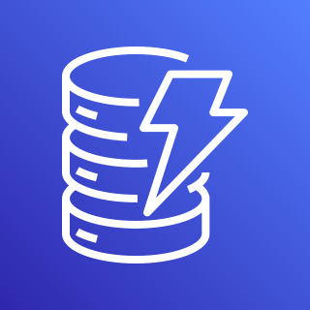
Demo AWS Topology
AWS Cloud
Region us-east-1
A
Amazon Cognito
Browser
/cup
JWT
/demo/cup
/CUP
/CIP
AWS API Gateway
AWS Lambda
Amazon DynamoDB
AWS SDK
/GOOGLE

Slide 15
Demo AWS Topology
AWS Cloud
Region us-east-1
B
Amazon Cognito
Browser
/CUP
/CIP
AWS API Gateway
AWS Lambda
Amazon DynamoDB
AWS SDK
/GOOGLE

Slide 16
Demo AWS Topology
AWS Cloud
Region us-east-1
Step 1: Authenticate to Cognito User Pool
B
Amazon Cognito
Browser
/CUP
/CIP
AWS API Gateway
AWS Lambda
Amazon DynamoDB
AWS SDK
/GOOGLE

Slide 17
Demo AWS Topology
AWS Cloud
Region us-east-1
Step 2: If Successful Receive JWT Token
B
Amazon Cognito
Browser
JWT
/CUP
/CIP
AWS API Gateway
AWS Lambda
Amazon DynamoDB
AWS SDK
/GOOGLE

Slide 18
Demo AWS Topology
AWS Cloud
Region us-east-1
Step 3: Exchange for IAM Credential
B
Amazon Cognito
Browser
JWT
/CUP
/CIP
AWS API Gateway
AWS Lambda
Amazon DynamoDB
AWS SDK
/GOOGLE

Slide 19

Demo AWS Topology
AWS Cloud
Region us-east-1
Step 4: If Successful Receive IAM Credential
B
Amazon Cognito
Browser
JWT
/CUP
IAM
credential
/CIP
AWS API Gateway
AWS Lambda
Amazon DynamoDB
AWS SDK
/GOOGLE

Slide 20
Demo AWS Topology
AWS Cloud
Region us-east-1
B
Amazon Cognito
Browser
JWT
/CUP
/demo/cip
IAM
credential
/CIP
AWS API Gateway
AWS Lambda
Amazon DynamoDB
AWS SDK
/GOOGLE

Slide 21
Demo AWS Topology
AWS Cloud
Region us-east-1
B
Amazon Cognito
Browser
JWT
/CUP
/demo/cip
/cip
IAM
credential
/CIP
AWS API Gateway
AWS Lambda
Amazon DynamoDB
AWS SDK
/GOOGLE

Slide 22
Demo AWS Topology
AWS Cloud
Region us-east-1
B
Amazon Cognito
Browser
JWT
/CUP
/demo/cip
/cip
IAM
credential
/CIP
AWS API Gateway
AWS Lambda
Amazon DynamoDB
AWS SDK
/GOOGLE

Slide 23
Demo AWS Topology
AWS Cloud
Region us-east-1
B
Amazon Cognito
Browser
JWT
/CUP
/demo/cip
/cip
IAM
credential
/CIP
AWS API Gateway
AWS Lambda
Amazon DynamoDB
AWS SDK
/GOOGLE

Slide 24
Demo AWS Topology
AWS Cloud
Region us-east-1
C
Amazon Cognito
Browser
/CUP
/CIP
AWS API Gateway
AWS Lambda
Amazon DynamoDB
AWS SDK
/GOOGLE

Slide 25
Demo AWS Topology
AWS Cloud
Region us-east-1
Step 1: Authenticate to Cognito User Pool
C
Amazon Cognito
Browser
/CUP
/CIP
AWS API Gateway
AWS Lambda
Amazon DynamoDB
AWS SDK
/GOOGLE

Slide 26
Demo AWS Topology
AWS Cloud
Region us-east-1
Step 2: Redirect to Authenticate with Okta
302 to okta
C
Amazon Cognito
Browser
/CUP
/CIP
AWS API Gateway
AWS Lambda
Amazon DynamoDB
AWS SDK
/GOOGLE

Slide 27

Demo AWS Topology
AWS Cloud
Region us-east-1
Step 3: Login to Okta following Code Grant
C
Amazon Cognito
Browser
/CUP
/CIP
AWS API Gateway
AWS Lambda
Amazon DynamoDB
AWS SDK
/GOOGLE

Slide 28

Demo AWS Topology
AWS Cloud
Region us-east-1
Step 4: If successful redirect with code to
Cognito via browser.
C
Amazon Cognito
Browser
/CUP
Code
/CIP
Angular App
AWS API Gateway
AWS Lambda
Amazon DynamoDB
AWS SDK
/GOOGLE

Slide 29
Demo AWS Topology
AWS Cloud
Region us-east-1
Step 5: Perform login request with code.
Code
C
Amazon Cognito
Browser
/CUP
Angular App
/CIP
AWS API Gateway
AWS Lambda
Amazon DynamoDB
AWS SDK
/GOOGLE

Slide 30
Demo AWS Topology
AWS Cloud
Region us-east-1
Step 6: If Successful Receive JWT Token
C
Amazon Cognito
Browser
JWT
/CUP
Angular App
/CIP
AWS API Gateway
AWS Lambda
Amazon DynamoDB
AWS SDK
/GOOGLE

Slide 31
Demo AWS Topology
AWS Cloud
Region us-east-1
C
Amazon Cognito
Browser
/cup
JWT
/demo/cup
/CUP
/CIP
AWS API Gateway
AWS Lambda
Amazon DynamoDB
AWS SDK
/GOOGLE

Slide 32
Demo AWS Topology
AWS Cloud
Region us-east-1
D
Amazon Cognito
Browser
JWT
/CUP
/demo/cip
/cip
IAM
credential
/CIP
AWS API Gateway
AWS Lambda
Amazon DynamoDB
AWS SDK
/GOOGLE

